Slide 1

Mindreading & Joint Action
Mindreading & Joint Action
4. What Is Modularity?
butterfillS@ceu.hu
butterfillS@ceu.hu

Slide 2
Outline
Why we need a notion of modularity (§0)
There is a problem—current accounts of modularity are inadequate (§1).
I have a solution (§2).
This solution implies a constraint on how modules might explain cognitive development (§3).
Illustration: speech perception (§4).

Slide 3
Why we need a notion of modularity (§0)

Slide 4
Are human adults’ abilities to represent beliefs automatic?
track
Notes:
see handwritten notes

Slide 5
Are human adults’ abilities to represent beliefs automatic?
--- yes: Kovács et al (2010), Schneider et al (2011).
track

Slide 6
Are human adults’ abilities to represent beliefs automatic?
--- yes: Kovács et al (2010), Schneider et al (2011).
--- no: Back & Apperly (2010), Apperly et al (2010).
track

Slide 7
1. There are subjects who can pass A-tasks but cannot pass B-tasks.
2. These subjects’ success on A-tasks is explained by the fact that they can represent (false) beliefs
3. These subjects’ failure on B-tasks is explained by the fact that they cannot represent (false) beliefs
track
track

Slide 8
1. There are subjects who can pass A-tasks but cannot pass B-tasks.
2. These subjects’ success on A-tasks is explained by the fact that they can represent (false) beliefs
3. These subjects’ failure on B-tasks is explained by the fact that they cannot represent (false) beliefs
track
using a simple model
track
using a sophisticated model
Notes:
This allowed us to avoid contradiction but it doesn’t entirely solve the puzzle.
I don't think it resolves the puzzle all by itself.
The problem is this.
[A and B are reversed in following!]
Success on many standard false belief tasks in Category A is in principle possible using only a very simple measure for representing beliefs.
Further, Category A tasks do not seem to differ from Category B tasks with respect to which measures for representing beliefs could in principle explain success on these tasks.
So the view raises and does not answer the question of why children continue to systematically fail false belief tasks in Category A years after they can pass false belief tasks in Category B.

Slide 9
1. There are subjects who can pass A-tasks but cannot pass B-tasks.
2. These subjects’ success on A-tasks is explained by the fact that they can represent (false) beliefs
3. These subjects’ failure on B-tasks is explained by the fact that they cannot represent (false) beliefs
track
using a simple model
track
using a sophisticated model
Notes:
So it looks like we are still some way off resolving this puzzle.
Let’s step back for a minute.
The form of puzzle we face with the development of mindreading recurs in other cases as well.
For example, there is a version of the puzzle in understanding infants’ physical reasoning.

Slide 10
— Neil Berthier, De Blois, et al. (2000: 395)
Notes:
When do infants first represent physical properties. In particular, when do they first represent barriers as having the power to stop moving objects? V-of-E ... vs. action-based measures ...

Slide 11
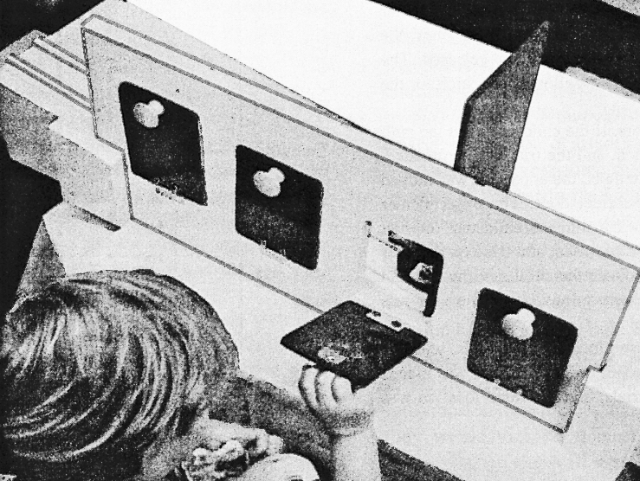
— Neil Berthier, De Blois, et al. (2000: 395)

Slide 12
— Neil Berthier, De Blois, et al. (2000: 395)

Slide 13
— Neil Berthier, De Blois, et al. (2000: 395)
Notes:
One common error pattern among older children – look behind door next to barrier but on wrong side of it

Slide 14
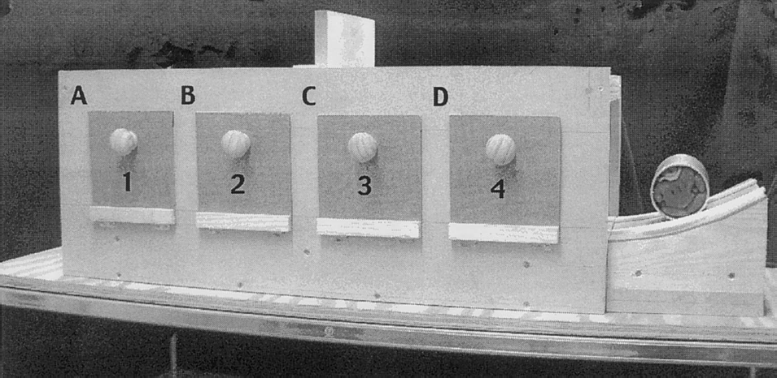
(Hood et al, 2003)
Notes:
2.5-year-olds look longer when experimenter removes the ball from behind the wrong door, but don't reach to the correct door

Slide 15
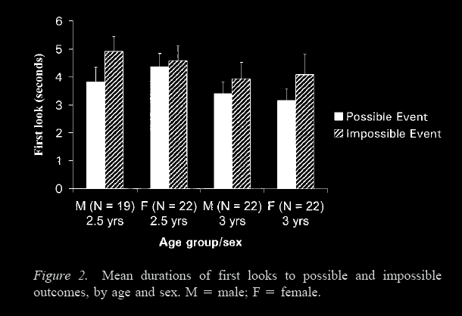
Looking time reveals causal understanding and 2.5- and 3-year olds
-- Hood et al (2003: 65)
(Hood et al, 2003)
Notes:
2.5-year-olds look longer when experimenter removes the ball from behind the wrong door, but don't reach to the correct door
Although the most studied case is false belief, this discrepancy between measures is very common. It occurs for tests involving physical reasoning, number, and speech; and probably also involving agency and space.

Slide 16
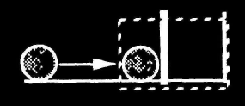

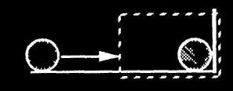
habituation
consistent
inconsistent
Notes:
can also do this with habituation (not just V-of-E) ---- mention this now because I’ll use it later

Slide 17
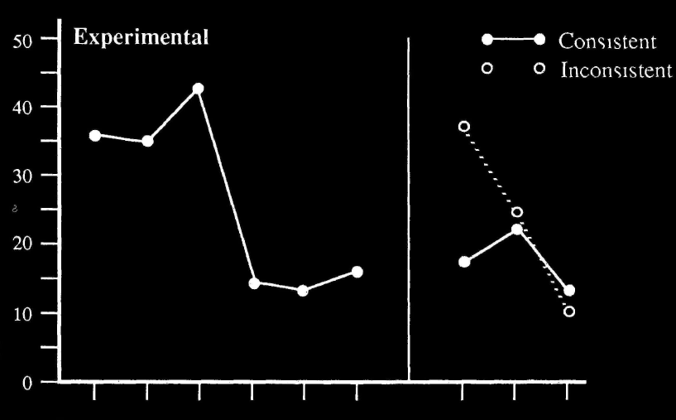
habituation
consistent
inconsistent
Sources Spelke 1991, Gergely, Csibra & Biro 1995, Csibra 2003 p. 125 fig. 6, Mark Steyvers’ web page for PSYCH 140C

Slide 18
1. There are subjects who can pass A-tasks but cannot pass B-tasks.
2. These subjects’ success on A-tasks is explained by the fact that they can represent X
3. These subjects’ failure on B-tasks is explained by the fact that they cannot represent X
track
track
Notes:
X = mechanical relations among objects
Because there is apparently conflicting data about when humans can first represent beliefs, physical properties, and phonetic gestures.
Resolving the apparent conflict plausibly involves distinguishing modular from non-modular representations.

Slide 19
1. There are subjects who can pass A-tasks but cannot pass B-tasks.
2. These subjects’ success on A-tasks is explained by the fact that they can represent X
3. These subjects’ failure on B-tasks is explained by the fact that they cannot represent X
track
in a modular process
track
in a non-modular process
Notes:
These apparently conflicting patterns of performance in human subjects are often explained on the hypothesis that multiple representational systems are involved.
This is true not just for physical properties, but also for representations of faces \citep{Morton:1991lr}, phonemes, number \citep[e.g.][]{feigenson_tracking_2003}, agency and space \citep{Carey:1996hl}.
In these domains and others, it seems we have to distinguish
representations that paradigmatically feature in reflective thought and talk
from
representations that feature in modules or core systems.
These modules are typically functional early in development and throughout most of the life course,
make few or no demands on scarce cognitive resources like working memory,
and are limited and inflexible with respect to the information they can process and output.

Slide 20
1. There are subjects who can pass A-tasks but cannot pass B-tasks.
2. These subjects’ success on A-tasks is explained by the fact that they can represent X
3. These subjects’ failure on B-tasks is explained by the fact that they cannot represent X
track
in a modular process
track
in a non-modular process
Notes:
How plausible is the idea that we can explain the puzzle about tracking beliefs in the same way?
In the case of physics, the contrast seems to be between looking times and action.
This doesn’t fit with what we know about false belief very well.
For we know that one-year-old infants succeed on false belief tasks which involve actively helping others, interpreting their utterances and pointing to provide information \citep{en_1783,Knudsen:2011fk,southgate:2010fb},
and that older children still fail some nonverbal false belief tasks \citep{Call:1999co}.
So if our inspiration for distinguishing modular from non-modular cognition were only physical reasoning, it doesn’t look like the distinction would be very helpful to us.
For this reason I want to introduce another case which motivates modular/nonmodular distinctions, one which I think there might be a closer parallel with mindreading: speech.

Slide 21
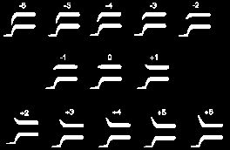
ba-da-ga
source http://www.columbia.edu/itc/psychology/rmk/T2/T2.2b.html
Notes:
first part: just some basic facts about speech (not speech perception yet).
Twelve speech sounds. Although each differs from its neighbour acoustically by a fixed amount, most subjects label and discriminate them as if they fell into three categories, /ba/, /da/, and /ga/. From http://www.columbia.edu/itc/psychology/rmk/T2/T2.2b.html

Slide 22
ba-da-ga
ba
da
da
ga
modified from http://www.columbia.edu/itc/psychology/rmk/T2/T2.2b.html

Slide 23
ba-da-ga
ba
da
da
ga
modified from http://www.columbia.edu/itc/psychology/rmk/T2/T2.2b.html

Slide 24
ba-da-ga
ba
da
da
ga
modified from http://www.columbia.edu/itc/psychology/rmk/T2/T2.2b.html

Slide 25
ba-da-ga
ba
da
da
ga
modified from http://www.columbia.edu/itc/psychology/rmk/T2/T2.2b.html
Notes:
we can ask where the category boundaries fall. Which features of the stimuli best predict category membership?
Initially tempting to suppose that categories are acoustic in nature but ...
Liberman and Mattingly show that in the case of speech, category boundaries typically correspond to differences between intended phonic gestures.
Let’s look at some of the evidence for this view

Slide 26
ba-da-ga
ba
da
da
ga
modified from http://www.columbia.edu/itc/psychology/rmk/T2/T2.2b.html
Notes:
context shifts (e.g. pen in mouth, accent, rate of speech)
In humans the location of perceptual category boundaries changes depending on factors such as the speaker’s dialect (Repp and Liberman 1987) and the rate at which the speaker talks (Nygaard and Pisoni 1995: 72–5); both factors dramatically affect which sounds are produced. This means that whether two auditory stimuli fall into the same perceptual category will vary between speakers and situations and so cannot be inferred from local acoustic properties alone.

Slide 27
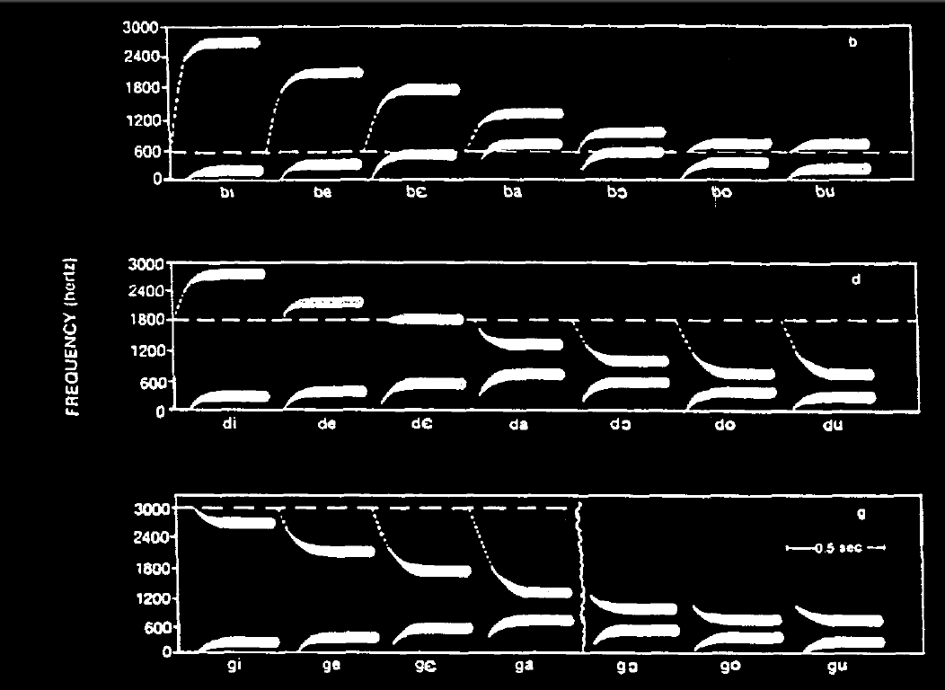
source Jusczyk (1997: 44)
Notes:
context shift: different neighbours
Further variation in the location of perceptual category boundaries relative to acoustic characteristics arises from the different ways phonemes are produced in different surroundings (Fig. 4). Such differences may be in part comparable to differences in the way an act of reaching is performed depending on which actions precede and follow it; these differences may also be partly due to speakers’ articulatory gestures overlapping rather than production of each new gesture beginning only after the previous one has been completed (see A. M. Liberman and Whalen 2000: 191 on coarticulation; Fowler 1995; Farnetani and Recasens 1999).

Slide 28
source Jusczyk (1997: 44)

Slide 29

i z a b e l s l e p t a n d l i l i k r a i d
Notes:
co-articulation.

Slide 30
The objects of speech perception are ‘the intended phonic gestures of the speaker’ (Liberman and Mattingly 1985)
i z a b e l s l e p t a n d l i l i k r a i d
Notes:
Which features of the stimuli best predict category membership? Liberman and Mattingly show that in the case of speech, category boundaries typically correspond to differences between intended phonic gestures. What is identified in speech perception are gestures rather than sounds.

Slide 31
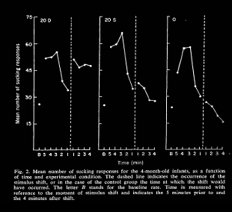
60
45
mean number of sucking responses per minute
30
15
source Eimas, Siqueland, et al. (1971: 304, figure 2)
Notes:
When do infants first represent phonemes? Habituation: from around four months ...

Slide 32
60
45
mean number of sucking responses per minute
30
15
source Eimas, Siqueland, et al. (1971: 304, figure 2)
Notes:
Note that prelinguistic infants’ categorical perception is adult-like in the sense that the effects of speaker and context on where perceptual category boundaries fall mentioned above are also found in prelinguistic infants( Kuhl 1987: 376–82; and 2004: 834).
... but it’s not just habituation ... of course older children, two-year-olds say, rely on phonetic distinctions in order to communicate by language

Slide 33
Tests of phonological awareness:
- sorting according to initial phoneme
- tapping once per phoneme
- phoneme segmentation
- phoneme blending
- phoneme elision
- word completion
Success on these tasks is statistically explained by a single factor
Notes:
Despite the early appearance of categorical perception of speech, it takes around four years before children are first able to form beliefs about phonetic properties. The simplest evidence that children cannot acquire beliefs about phonetic properties until around four years of age is their systematic failure on tests which require them to recognise, distinguish or manipulate phonemes. To illustrate, in a standard test for phoneme identity children are told that a puppet likes words beginning with /d/ and hates words beginning with /t/ and asked to sort words accordingly (Treiman, Broderick, et al. 1998). While failure on this one task might be consistent with being in a position to have beliefs about phonetic properties, children’s systematic failure on a whole range of tasks like this is not.

Slide 34
Tests of phonological awareness:
- sorting according to initial phoneme
- tapping once per phoneme
- phoneme segmentation
- phoneme blending
- phoneme elision
- word completion
Success on these tasks is statistically explained by a single factor
Notes:
These tasks are all thought to be measures of a single ability, “phonological awareness”, distinct from awareness of rhymes and syllables (Anthony and Francis 2005: 256; Høien, Lundberg, et al. 1995).
Children’s and adults’ untrained judgements about phonemes are often surprisingly inaccurate, and they are typically influenced by acoustic features such as sonority as well as their knowledge of spelling and linguistic structure (Scarborough, Ehri, et al. 1998; Treiman and Cassar 1997; Lehtonen and Treiman 2007; Hallé, Chéreau and Segui 2000). Categorical perception is not similarly affected by these factors (Serniclaes, Ventura, et al. 2005). This is evidence for the hypothesis that whereas categorical perception tracks articulatory gestures, recognitional concepts track acoustic properties.

Slide 35
1. There are subjects who can pass A-tasks but cannot pass B-tasks.
2. These subjects’ success on A-tasks is explained by the fact that they can represent X
3. These subjects’ failure on B-tasks is explained by the fact that they cannot represent X
track
in a modular process
track
in a non-modular process
Notes:
So the question was, why do we need a notion of modularity or core knowledge (or whatever).
And the answer is:
--- because it enables us to explain otherwise apparently contradictory patterns of evidence in a wide range of cases: not only mindreading, but also physics, speech, faces and number.

Slide 36
1. There are subjects who can pass A-tasks but cannot pass B-tasks.
2. These subjects’ success on A-tasks is explained by the fact that they can represent (false) beliefs
3. These subjects’ failure on B-tasks is explained by the fact that they cannot represent (false) beliefs
track
in a modular process
track
in a non-modular process
Notes:
So I am supposing, in particularly, that the modular/nonmodular distinction can apply to our case.

Slide 37
1. There are subjects who can pass A-tasks but cannot pass B-tasks.
2. These subjects’ success on A-tasks is explained by the fact that they can represent (false) beliefs
3. These subjects’ failure on B-tasks is explained by the fact that they cannot represent (false) beliefs
track
using a simple model
in a modular process
track
using a sophisticated model
in a non-modular process
Notes:
But now you might be thinking, if we’re going to appeal to modularity, then why did we need to introduce this stuff about measures ...
To answer this question we need first to look more closely at what modularity (or core knowledge) is.
In advance of thinking carefully, it does indeed seem that we don’t need notions like model &c.
But once we have thought more carefully about modularity, we will be able to see that there are limits on the kinds of cognition that can be modular.
And, in particular, only when mindreading involves relatively simple models and measures will it be possible for mindreading to be modular.
So the two points are related, although they don’t initially seem to be.
To make sense of modular mindreading you need relatively simple measures of belief; and these relatively simple measures need to be constructed; in describing minimal theory of mind we have described a measure of belief which is flexible enough to explain success on a variety of false belief tasks but which could also be implemented efficiently, without placing demands on executive function, working memory and attention.

Slide 38

There is a problem

Slide 39
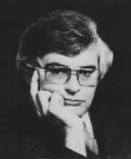
Modules
1. they are ‘the psychological systems whose operations present the world to thought’;
2. they ‘constitute a natural kind’; and
3. there is ‘a cluster of properties that they have in common … [they are] domain-specific computational systems characterized by informational encapsulation, high-speed, restricted access, neural specificity, and the rest’
(Fodor 1983: 101)

Slide 40


Modules
1. they are ‘the psychological systems whose operations present the world to thought’;
2. they ‘constitute a natural kind’; and
3. there is ‘a cluster of properties that they have in common … [they are] domain-specific computational systems characterized by informational encapsulation, high-speed, restricted access, neural specificity, and the rest’
(Fodor 1983: 101)
Notes:
Not all researchers agree about the properties of modules. Sperber and Wilson, for example, ‘use “module” in a looser sense than the one suggested by Fodor, to mean a domain- or task-specific autonomous computational mechanism’ (2002: 9)

Slide 41

Modules
1. they are ‘the psychological systems whose operations present the world to thought’;
2. they ‘constitute a natural kind’; and
3. there is ‘a cluster of properties that they have in common … [they are] domain-specific computational systems characterized by informational encapsulation, high-speed, restricted access, neural specificity, and the rest’
(Fodor 1983: 101)
Notes:
Max Coltheart suggests that Fodor should have defined a module simply as ‘a cognitive system whose application is domain specific’ (1999: 118).

Slide 42

Modules
1. they are ‘the psychological systems whose operations present the world to thought’;
2. they ‘constitute a natural kind’; and
3. there is ‘a cluster of properties that they have in common … [they are] domain-specific computational systems characterized by informational encapsulation, high-speed, restricted access, neural specificity, and the rest’
(Fodor 1983: 101)
Notes:
Simon Baron-Cohen rejects the claim that all modules are informationally encapsulated on the grounds that it is useful to suppose that some modules can interact with each other.

Slide 43
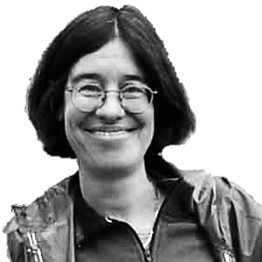
Modules
1. they are ‘the psychological systems whose operations present the world to thought’;
2. they ‘constitute a natural kind’; and
3. there is ‘a cluster of properties that they have in common … [they are] domain-specific computational systems characterized by informational encapsulation, high-speed, restricted access, neural specificity, and the rest’
(Fodor 1983: 101)
Notes:
And Elizabeth Spelke operates with a notion of ‘core knowledge systems’ which resemble Fodor’s modules in being domain-specific and informationally encapsulated (Spelke 2000: 1233, 2003: 291) but may differ from them in other respects.

Slide 44
modular cognition
happens here
syntax
space & time
agents
central system
number
general reasoning
happens here

Slide 45
`it seems doubtful that the often long lists of correlated attributes should come as a package ... the process architecture of social cognition is still very much in need of a detailed theory’
(Adolphs 2012: 759)
Notes:
... actually even if we focus on just one ...

Slide 46
Computation is the essence
of modularity

Slide 47
The Computational Theory of the Mind
’Thinking is computation’ (Fodor 1998: 9).
Notes:
‘modern philosophers … have no theory of thought to speak of. I do think this is appalling; how can you seriously hope for a good account of belief if you have no account of belief fixation?’ (Fodor 1987: 147)

Slide 48
The Computational Theory of the Mind
’Thinking is computation’ (Fodor 1998: 9).

Slide 49
The Computational Theory of the Mind
’Thinking is computation’ (Fodor 1998: 9).
Notes:
To understand this we have to step back and ask what a theory of thought has to achieve.
What does a theory of thought have to achieve? Fact to be explained: “causal relations among propositional attitudes [beliefs and desires] somehow typically contrive to respect their relations of content” (Fodor 1987: 12).

Slide 50
The Computational Theory of the Mind
’Thinking is computation’ (Fodor 1998: 9).
Thoughts …
(a) have intentional content;
(b) have a systematic effect on thought and action; and
(c) normally affect thought and action in ways that are justified given their contents.
Notes:
What does a theory of thought have to achieve? Fact to be explained: “causal relations among propositional attitudes [beliefs and desires] somehow typically contrive to respect their relations of content” (Fodor 1987: 12). More carefully:
Thoughts …
(a) have intentional content;
(b) have a systematic effect on thought and action; and
(c) normally affect thought and action in ways that are justified given their contents.
Puzzle: How could anything have properties (a)-(c)?

Slide 51
The Computational Theory of the Mind
’Thinking is computation’ (Fodor 1998: 9).
Thoughts …
(a) have intentional content;
(b) have a systematic effect on thought and action; and
(c) normally affect thought and action in ways that are justified given their contents.
‘Turing’s account of thought-as-computation showed us how to specify causal relations among mental symbols that are reliably truth-preserving’ (Fodor 1998: 10).
Notes:
So there’s no special puzzle about how computational states could have properties (a) to (c). That’s why computers are relevant.

Slide 52
The Computational Theory of the Mind
’Thinking is computation’ (Fodor 1998: 9).
Thoughts …
(a) have intentional content;
(b) have a systematic effect on thought and action; and
(c) normally affect thought and action in ways that are justified given their contents.
‘Turing’s account of thought-as-computation showed us how to specify causal relations among mental symbols that are reliably truth-preserving’ (Fodor 1998: 10).
Notes:
computational processes— they’re the processes that computers implement.
In particular, computational processes have the following features::
‘The operations of the machine consist entirely of transformations of symbols;
‘in the course of performing these operations, the machine is sensitive solely to syntactic properties of the symbols;
‘and the operations that the machine performs on the symbols are entirely confined to altering their shapes.’
— Fodor, Psychosemantics (1987: 19)

Slide 53
The Computational Theory of the Mind
’Thinking is computation’ (Fodor 1998: 9).
Thoughts …
(a) have intentional content;
(b) have a systematic effect on thought and action; and
(c) normally affect thought and action in ways that are justified given their contents.
Thought: Q
Thought: P&Q
Representation1
Representation2
‘Turing’s account of thought-as-computation showed us how to specify causal relations among mental symbols that are reliably truth-preserving’ (Fodor 1998: 10).
‘Turing’s account of thought-as-computation showed us how to specify causal relations among mental symbols that are reliably truth-preserving’ (Fodor 1998: 10).
Notes:
but how is this relevant to thought? Let’s suppose that to have a thought with a particualr content Q is to stand in some relation to a representation which has content Q.
Let’s supppose, further, that:
i. Representations have syntactic properties.
ii. The processes by which representations are acquired and acted upon are computational processes.
iii. These computational processes are such as to ensure that the causal roles of representations are normally in harmony with their justificatory roles.
This, (i)-(iii), is CTM

Slide 54
The Computational Theory of the Mind
’Thinking is computation’ (Fodor 1998: 9).
Thoughts …
(a) have intentional content;
(b) have a systematic effect on thought and action; and
(c) normally affect thought and action in ways that are justified given their contents.
Thought: Q
Thought: P&Q
computation
Representation2
Representation1
‘Turing’s account of thought-as-computation showed us how to specify causal relations among mental symbols that are reliably truth-preserving’ (Fodor 1998: 10).
‘Turing’s account of thought-as-computation showed us how to specify causal relations among mental symbols that are reliably truth-preserving’ (Fodor 1998: 10).
Notes:
but how is this relevant to thought? Let’s suppose that to have a thought with a particualr content Q is to stand in some relation to a representation which has content Q.
Let’s supppose, further, that:
i. Representations have syntactic properties.
ii. The processes by which representations are acquired and acted upon are computational processes.
iii. These computational processes are such as to ensure that the causal roles of representations are normally in harmony with their justificatory roles.
This, (i)-(iii), is CTM

Slide 55
The Computational Theory of the Mind
’Thinking is computation’ (Fodor 1998: 9).
justification
Thoughts …
(a) have intentional content;
(b) have a systematic effect on thought and action; and
(c) normally affect thought and action in ways that are justified given their contents.
Thought: Q
Thought: P&Q
computation
Representation2
Representation1
‘Turing’s account of thought-as-computation showed us how to specify causal relations among mental symbols that are reliably truth-preserving’ (Fodor 1998: 10).
‘Turing’s account of thought-as-computation showed us how to specify causal relations among mental symbols that are reliably truth-preserving’ (Fodor 1998: 10).
Notes:
but how is this relevant to thought? Let’s suppose that to have a thought with a particualr content Q is to stand in some relation to a representation which has content Q.
Let’s supppose, further, that:
i. Representations have syntactic properties.
ii. The processes by which representations are acquired and acted upon are computational processes.
iii. These computational processes are such as to ensure that the causal roles of representations are normally in harmony with their justificatory roles.
This, (i)-(iii), is CTM

Slide 56
The Computational Theory of the Mind
’Thinking is computation’ (Fodor 1998: 9).
justification
Thought: Q
Thought: P&Q
computation
Representation2
Representation1
‘Turing’s account of thought-as-computation showed us how to specify causal relations among mental symbols that are reliably truth-preserving’ (Fodor 1998: 10).
‘Turing’s account of thought-as-computation showed us how to specify causal relations among mental symbols that are reliably truth-preserving’ (Fodor 1998: 10).
Notes:
So that’s what ‘thinking is computation’ means.

Slide 57
The Computational Theory of the Mind
’Thinking is computation’ (Fodor 1998: 9).
‘sooner or later, we will all have to give up on the Turing story as a general account of how the mind works’
(Fodor 2000: 47)

Slide 58
Fodor’s (?) argument
1. Computational processes are not sensitive to context-dependent relations among representations.
2. Thinking sometimes involves being sensitive to context-dependent relations among representations as such.
3. Therefore, not all thinking is computation.

Slide 59
Fodor’s (?) argument
1. Computational processes are not sensitive to context-dependent relations among representations.
2. Thinking sometimes involves being sensitive to context-dependent relations among representations as such.
3. Therefore, not all thinking is computation.

Slide 60
Fodor’s (?) argument
1. Computational processes are not sensitive to context-dependent relations among representations.
2. Thinking sometimes involves being sensitive to context-dependent relations among representations as such.
3. Therefore, not all thinking is computation.
(e.g. the relation … is adequate evidence for me to accept that …)

Slide 61
Fodor’s (?) argument
1. Computational processes are not sensitive to context-dependent relations among representations.
2. Thinking sometimes involves being sensitive to context-dependent relations among representations as such.
3. Therefore, not all thinking is computation.
(e.g. the relation … is adequate evidence for me to accept that …)

Slide 62
Fodor’s (?) argument
1. Computational processes are not sensitive to context-dependent relations among representations.
2. Thinking sometimes involves being sensitive to context-dependent relations among representations as such.
3. Therefore, not all thinking is computation.
1. Associative learning processes do not involve retrospective re-evaluation.
2. Learning does sometimes involve retrospective re-evaluation.
3. Therefore, not all learning is associative.

Slide 63
Fodor’s (?) argument
1. Computational processes are not sensitive to context-dependent relations among representations.
2. Thinking sometimes involves being sensitive to context-dependent relations among representations as such.
3. Therefore, not all thinking is computation.
1. Associative learning processes do not involve retrospective re-evaluation.
2. Learning does sometimes involve retrospective re-evaluation.
3. Therefore, not all learning is associative.

Slide 64
1. Associative learning processes do not involve retrospective re-evaluation.
2. Learning does sometimes involve retrospective re-evaluation.
3. Therefore, not all learning is associative.
t1
A
B

Slide 65
1. Associative learning processes do not involve retrospective re-evaluation.
2. Learning does sometimes involve retrospective re-evaluation.
3. Therefore, not all learning is associative.
t1
A
B
t2
B

Slide 66
Fodor’s (?) argument
1. Computational processes are not sensitive to context-dependent relations among representations.
2. Thinking sometimes involves being sensitive to context-dependent relations among representations as such.
3. Therefore, not all thinking is computation.
1. Associative learning processes do not involve retrospective re-evaluation.
2. Learning does sometimes involve retrospective re-evaluation.
3. Therefore, not all learning is associative.

Slide 67
Fodor’s (?) argument
1. Computational processes are not sensitive to context-dependent relations among representations.
2. Thinking sometimes involves being sensitive to context-dependent relations among representations as such.
3. Therefore, not all thinking is computation.
1. Associative learning processes do not involve retrospective re-evaluation.
2. Learning does sometimes involve retrospective re-evaluation.
3. Therefore, not all learning is associative.

Slide 68
‘the Computational Theory is probably true at most of only the mind’s modular parts. … a cognitive science that provides some insight into the part of the mind that isn’t modular may well have to be different, root and branch’
(Fodor 2000: 99)

Slide 69
Fodor’s (?) argument
1. Computational processes are not sensitive to context-dependent relations among representations.
2. Thinking sometimes involves being sensitive to context-dependent relations among representations as such.
3. Therefore, not all thinking is computation.
1. Associative learning processes do not involve retrospective re-evaluation.
2. Learning does sometimes involve retrospective re-evaluation.
3. Therefore, not all learning is associative.

Slide 70
Fodor’s (?) argument
1. Computational processes are not sensitive to context-dependent relations among representations.
2. Thinking sometimes involves being sensitive to context-dependent relations among representations as such.
3. Therefore, not all thinking is computation.
1. Associative learning processes do not involve retrospective re-evaluation.
2. Learning does sometimes involve retrospective re-evaluation.
3. Therefore, not all learning is associative.
Notes:
This explains information encapsulation!

Slide 71
Fodor’s (?) argument
1. Computational processes are not sensitive to context-dependent relations among representations.
2. Thinking sometimes involves being sensitive to context-dependent relations among representations as such.
3. Therefore, not all thinking is computation.
1. Associative learning processes do not involve retrospective re-evaluation.
2. Learning does sometimes involve retrospective re-evaluation.
3. Therefore, not all learning is associative.
‘The informational encapsulation of the input systems is ... the essence of their modularity.’
(Fodor 1983: 71)
Notes:
And information encapsulation was the most important thing to explain

Slide 72
Fodor’s (?) argument
1. Computational processes are not sensitive to context-dependent relations among representations.
2. Thinking sometimes involves being sensitive to context-dependent relations among representations as such.
3. Therefore, not all thinking is computation.
1. Associative learning processes do not involve retrospective re-evaluation.
2. Learning does sometimes involve retrospective re-evaluation.
3. Therefore, not all learning is associative.
‘The informational encapsulation of the input systems is ... the essence of their modularity.’
(Fodor 1983: 71)
Notes:
We can also explain limited accessibility, but I’ll come to this later (the explanation is: computational process != process of thought thf. difference in representation)

Slide 73
Consequences for the role of modules in development

Slide 74
How do modules facilitate development?
(1) Role of modules …
Modules provide ‘a basic infrastructure for knowledge and its acquisition’
(Wellman and Gelman 1998: 524)

Slide 75
How do modules facilitate development?
(1) Role of modules …
Modules provide ‘a basic infrastructure for knowledge and its acquisition’
(Wellman and Gelman 1998: 524)
(2) How modules fulfil this role …
’The module … automatically provides a conceptual identification of its input for central thought … in exactly the right format for inferential processes’
(Leslie 1988: 193–4 my italics).

Slide 76
How do modules facilitate development?
(1) Role of modules …
Modules provide ‘a basic infrastructure for knowledge and its acquisition’
(Wellman and Gelman 1998: 524)
(2) How modules fulfil this role …
’The module … automatically provides a conceptual identification of its input for central thought … in exactly the right format for inferential processes’
(Leslie 1988: 193–4 my italics).
‘Core systems are conceptual and provide a foundation for the growth of knowledge’
(Carey & Spelke 1996: 520)

Slide 77
What are concepts?
The concept OBJECT is …
(a) that in virtue of having which we are able to reason about objects as such;
(b) that in virtue of having which we are able to compute information about objects as such.

Slide 78
How do modules facilitate development?
(1) Role of modules …
Modules provide ‘a basic infrastructure for knowledge and its acquisition’
(Wellman and Gelman 1998: 524)
(2) How modules fulfil this role …
’The module … automatically provides a conceptual identification of its input for central thought … in exactly the right format for inferential processes’
(Leslie 1988: 193–4 my italics).
‘Core systems are conceptual and provide a foundation for the growth of knowledge’
(Carey & Spelke 1996: 520)

Slide 79
How do modules facilitate development?
(1) Role of modules …
Modules provide ‘a basic infrastructure for knowledge and its acquisition’
(Wellman and Gelman 1998: 524)
(2) How modules fulfil this role …
’The module … automatically provides a conceptual identification of its input for central thought … in exactly the right format for inferential processes’
(Leslie 1988: 193–4 my italics).
associative process
physiological change
sensory experience
thought process

Slide 80
Perceiving & thinking about speech
Notes:
How does modular cognition of speech interface with general reasoning? Does it provide conceptual identifications of phonemes?

Slide 81
4 months: categorical perception of phonemes
3-4 years: phoneme judgements
Notes:
here’s what we had earlier; now let’s look at the pattern of development ...

Slide 82
4 months: categorical perception of phonemes
3-4 years: phoneme judgements
/r/
/p/
Notes:
acquisition of ability to think analytically about phonemes is gradual

Slide 83
4 months: categorical perception of phonemes
3-4 years: phoneme judgements
/r/
/p/
Notes:
Language is the bridge. Also in the case of mindreading --- language gets you from early, modular capacities that enable you to respond differently depending on others’ beliefs to being able to think analytically about mental states themselves.
furthermore, it typically appears thanks to the intervention of language. I.e. not direct route from the perceptual capacity to the analytic capacity.
So there are two puzzles for the claim that the module provides conceptual identification of phonemes:
1. why the gap of 2-3 years, and why the gradual emergence?
2. why do the representations of phonemes involved in phonological awareness differ systematically from those involved in categorical perception? It’s as if two systems of knowledge were involved.
So suppose that there is no conceptual identification.
We can still see a role for CP in the emergence of phonological awareness.
CP provides a signal of sameness or difference but without providing a representation of WHAT is different: a modification of the experience.
These experiences then provide the raw materials which children are able to (re)INTERPRET when they acquire phonological awareness, usually in conjunction with a writing system.

Slide 84
‘we believe that children’s performance depends on cognitive capacities that are continuous over human development’
(Spelke 2001: 336)
4 months: categorical perception of phonemes
3-4 years: phoneme judgements
/r/
/p/
Notes:
Two ways of understanding this: (1) modular capacity is retained by adults (true); (2) modular capacity is the sort of conceptual identification required for phonological awareness (false).

Slide 85
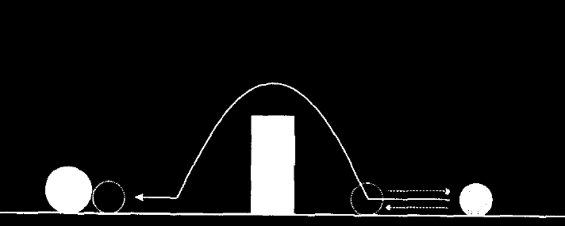
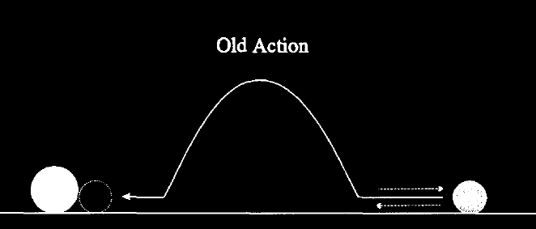
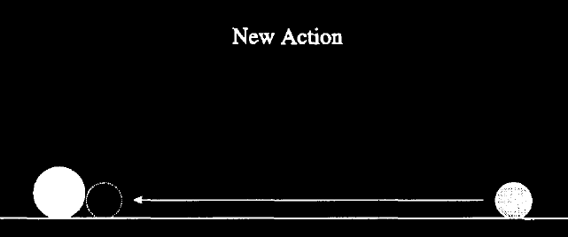
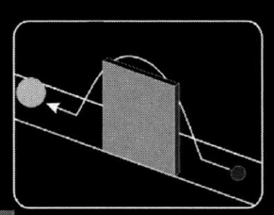
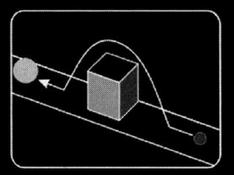
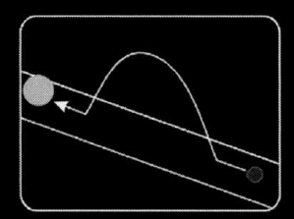
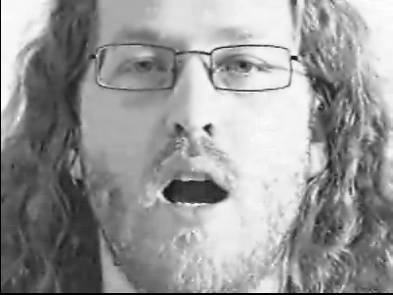
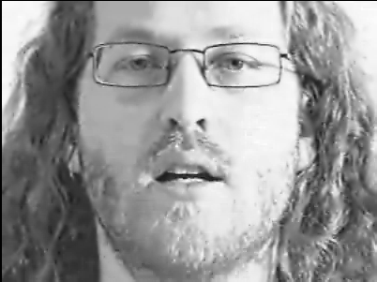
habituation
consistent
inconsistent
Sources Spelke 1991, Gergely, Csibra & Biro 1995, Csibra 2003 p. 125 fig. 6, Mark Steyvers’ web page for PSYCH 140C
Notes:
... in case they object that modularity can’t explain predictions ... the McGurk barrier case is an example of predicting an action

Slide 86

Conclusion

Slide 87
Conclusions
1. If modules exist, there is more to modularity than a cluster of features.
2. Modular cognition differs from thinking in being a different kind of process; specifically, in being a special kind of computational process.
3. The ‘concepts’ and ‘knowledge’ involved in modular cognition differ in kind from those involved in general reasoning.
4. The relation between modular cognition and general reasoning is indirect.
5. Categorical perception of speech provides a model of non-representational communication between modules and thought

Slide 88
1. There are subjects who can pass A-tasks but cannot pass B-tasks.
2. These subjects’ success on A-tasks is explained by the fact that they can represent (false) beliefs
3. These subjects’ failure on B-tasks is explained by the fact that they cannot represent (false) beliefs
track
using a simple model
in a modular process
track
using a sophisticated model
in a non-modular process
Notes:
So do we now have a solution to the puzzle? Only if the notion of modularity can explain the patterns of success and failure. I’m tempted to think that it can’t and that we need yet another ingredient. Speech perception: motor system is involved in identifying phonemes. This is a claim in addition to the claim that speech perception is modular. Similarly, claim that in tracking mechanical relations it is a perceptual object-tracking mechanism goes beyond claims about modularity. I think we also need to know more about the implementation details of mindreading. But here it’s time for me to stop talking about mindreading. This course is about *philosophical tools*. Philosophical tools are useful for understanding the space of possible explanations and for structuring questions, but you can’t expect them to actually answer the question. The conjectures I have offered are merely conjectures --- that mindreading is sometimes but not always modular, and that there are different models of the attitudes and different measures we can use to track others’ mental states. I want to suggest only that these conjectures are worth testing, that it would be interesting to know either way, that there is no reason yet to reject them ... but of course that we also don’t yet know whether they are true, and we can’t know whether they are true on the basis of purely philosophical arguments.

Slide 89
Nativism about knowledge
Not all knowledge is acquired by learning
Poverty of Stimulus Argument
(1) Experience alone wouldn’t enable us to know truths about X.
(2) But we do know truths about X.
Therefore:
(3) Some knowledge about X must be innate.
The Problem of Truth
Knowledge involves true beliefs and it’s hard to see how beliefs could be true unless acquired through learning.
Notes:
This is a PS:

Slide 91



Slide 92
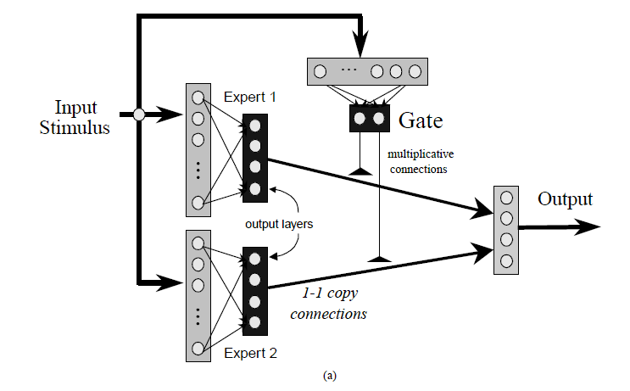
Dailey and Cotrell (1999), figure 2

Slide 93
’Specialized cognitive mechanisms can allow attention to go to specific properties or sets of properties. … this general idea can be extended to non-sensory concepts, and even to highly abstract concepts. For example, the ‘Michotte module’ allows young infants to attend to causes and effects, grounding the concept ‘cause’ without infants knowing anything about what causes really are (Leslie & Keeble, 1987). But once the child can selectively attend to the property in question, the child can have thoughts about that property, make observations about that property and, most importantly, can begin to learn things about that property’
(Gelman and Leslie 2001: 61)

Slide 94

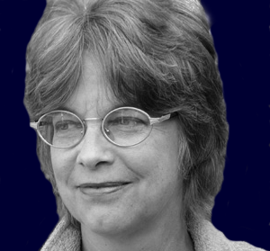
Core systems are ‘structures … just as specific as those that underlie animal cognition, human perception, and human action. Just as humans are endowed with multiple, specialized perceptual systems, so we are endowed with multiple systems for representing and reasoning about entities of different kinds.’
(Carey and Spelke 1996: 517)
’core systems are conceptual and provide a foundation for the growth of knowledge. … core systems are largely innate, encapsulated, and unchanging, arising from phylogenetically old systems built upon the output of innate perceptual analyzers.’
(Carey and Spelke 1996: 520)

Slide 95
* domain specificity
modules deal with ‘eccentric’ bodies of facts
* limited accessibility
representations in modules are not usually inferentially integrated with general knowledge
* information encapsulation
modules are unaffected by general knowledge or representations in other modules, i.e. ‘top down’ processing is limited
* innateness
the representations and operations of a module are genetically specified

Slide 97
agency, analogical reasoning, …
10 months: perception of launchings
2-4 years: causal concepts

Slide 98
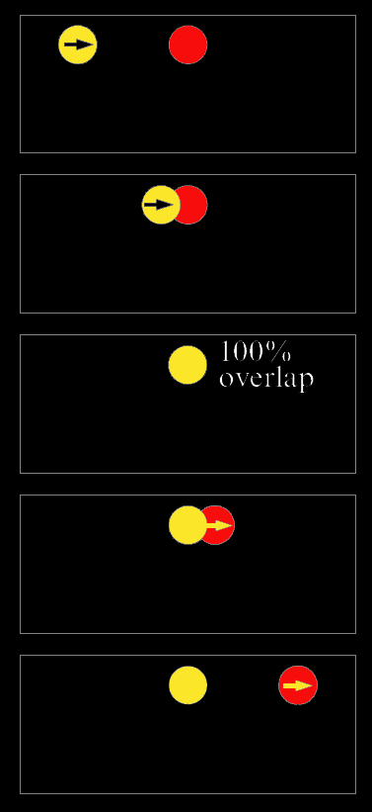
Scholl and Nakayama’s illusory causal crescents

Slide 99
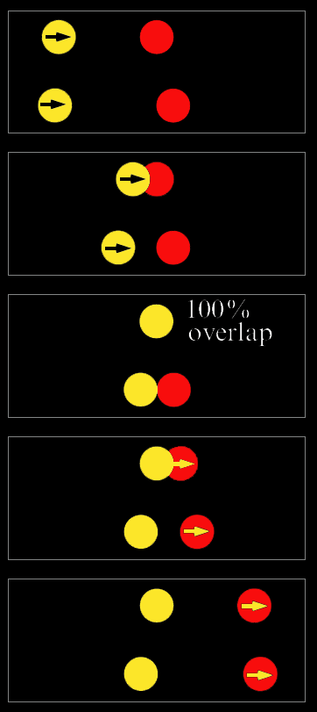
Scholl and Nakayama’s illusory causal crescents

Slide 100
Causal Perception Is Object Perception
distinct surfaces => different objects
continuity of motion => same object

Slide 101
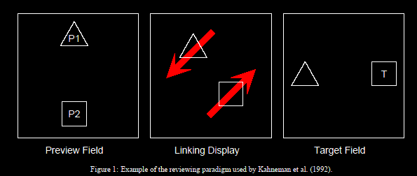
Object-specific preview-effect (Kahneman et al 1992)
’observers can identify target letters that matched the preview letter from the same object faster than they can identify target letters that matched the preview letter from the other object.’
(Krushke and Fragassi 1996 : 2)

Slide 102
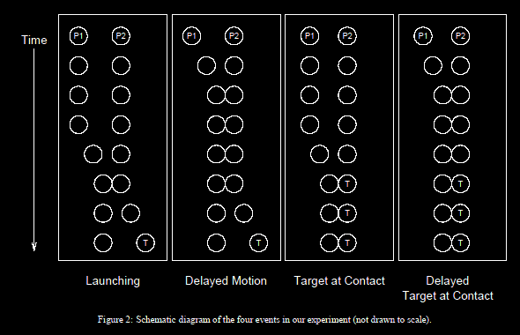
No object-specific preview effect at point of contact
Object-specific preview effect for the other object shortly after contact
(from Krushke and Fragassi 1996)

Slide 103
(from Krushke and Fragassi 1996)

Slide 104
How do modules facilitate development?
(1) Role of modules …
Modules provide ‘a basic infrastructure for knowledge and its acquisition’
(Wellman and Gelman 1998: 524)
(2) How modules fulfil this role …
’The module … automatically provides a conceptual identification of its input for central thought … in exactly the right format for inferential processes’
(Leslie 1988: 193–4 my italics).
’The building blocks of all our complex representations are the representations that are constructed from individual core knowledge systems.’
(Spelke 2003: 307)
Notes:
CUT!

Slide 105
Two notions of assembling …
(a) science-like …
’conceptual change in childhood is the same sort of process as is conceptual change in the history of science’
(Carey and Spelke 1994: 193)
(b) language-based …
’Once they have learnt these terms [’left’ and ‘blue’], the combinatorial machinery of natural language allows children to formulate and understand expressions such as left of the blue wall with no further learning’
(Spelke 2003: 296)
Notes:
CUT!

Slide 106
How do modules facilitate development?
(1) Role of modules …
Modules provide ‘a basic infrastructure for knowledge and its acquisition’
(Wellman and Gelman 1998: 524)
(2) How modules fulfil this role …
’The module … automatically provides a conceptual identification of its input for central thought … in exactly the right format for inferential processes’
(Leslie 1988: 193–4 my italics).
’The building blocks of all our complex representations are the representations that are constructed from individual core knowledge systems.’
(Spelke 2003: 307)
Notes:
CUT!

Slide 107
Habituation tasks: humans can represent phonetic structure from around age four months
Phonological awareness tasks: humans cannot represent phonetic structure until age 3-4 years
‘it does not follow from the fact that a child can easily distinguish bud from bat that he can therefore respond analytically to the phonemic structure that underlies the distinction’
(I. Liberman, Shankweiler, et al. 1974: 203).
4 months: categorical perception of phonemes
3-4 years: phoneme judgements
Notes:
[CUT from here to next section] This seems all very unproblematic. That’s why I mention it. Speech perception & phonological awareness give us a model for thinking about other cases. E.g. the case of belief.
But I we need to be careful here.
Merely labeling one kind of speech cognition ‘perceptual’ and the other ‘analytic’ does not do more than provide a formal way of avoiding the apparent conflict.

Slide 108
habituation
consistent
inconsistent
Sources Spelke 1991, Gergely, Csibra & Biro 1995, Csibra 2003 p. 125 fig. 6, Mark Steyvers’ web page for PSYCH 140C
Notes:
it’s not just speech

Slide 109
habituation
consistent
inconsistent
Sources Spelke 1991, Gergely, Csibra & Biro 1995, Csibra 2003 p. 125 fig. 6, Mark Steyvers’ web page for PSYCH 140C
Notes:
it’s not just speech

Slide 110
60
45
mean number of sucking responses per minute
30
15
source Eimas, Siqueland, et al. (1971: 304, figure 2)
Notes:
compare this!

Slide 111
habituation
consistent
inconsistent
Sources Spelke 1991, Gergely, Csibra & Biro 1995, Csibra 2003 p. 125 fig. 6, Mark Steyvers’ web page for PSYCH 140C
Notes:
it’s not just speech

Slide 112
habituation
consistent
inconsistent
Sources Spelke 1991, Gergely, Csibra & Biro 1995, Csibra 2003 p. 125 fig. 6, Mark Steyvers’ web page for PSYCH 140C
Notes:
it’s not just speech

Slide 113
habituation
consistent
inconsistent
Sources Spelke 1991, Gergely, Csibra & Biro 1995, Csibra 2003 p. 125 fig. 6, Mark Steyvers’ web page for PSYCH 140C
Notes:
it’s not just speech

Slide 114
habituation
consistent
inconsistent
Sources Spelke 1991, Gergely, Csibra & Biro 1995, Csibra 2003 p. 125 fig. 6, Mark Steyvers’ web page for PSYCH 140C
Notes:
it’s not just speech

Slide 115
habituation
consistent
inconsistent
Sources Spelke 1991, Gergely, Csibra & Biro 1995, Csibra 2003 p. 125 fig. 6, Mark Steyvers’ web page for PSYCH 140C
Notes:
in each case habituation and other methods suggest representation, whereas other tests suggest no representation.

Slide 116
Notes:
to make sense of modular mindreading you need relatively simple measures of belief; and these relatively simple measures need to be constructed; in describing minimal theory of mind we have described a measure of belief which is flexible enough to explain success on a variety of false belief tasks but which could also be implemented efficiently, without placing demands on executive function, working memory and attention. Minimal theory of mind may be what enables those with limited cognitive resources or little cognitive sophistication ... to track others’ beliefs.
This does allow us to avoid contradiction.
But of course this doesn’t solve the puzzle ... after all, minimalToM is enough for standard tasks ...
Next week is modularity

Slide 117
1. There are subjects who can pass A-tasks but cannot pass B-tasks.
2. These subjects’ success on A-tasks is explained by the fact that they can represent (false) beliefs
3. These subjects’ failure on B-tasks is explained by the fact that they cannot represent (false) beliefs
in a modular process
in a non-modular process
Notes:
The first step, then, is to distinguish two systems for representing beliefs, just as we have to distinguish multiple systems for representing causation, number, speech, space and the rest.
The distinction is between modular mindrreading and nonmodular mindreading.
But this distinction, although formally it removes the contradiction, raises a hard question.
How could belief ascription be modular?
On the face of it, anything you know, anything at all, can be relevant to a belief ascription. So representing and ascribing beliefs looks to be a paradigm case of the sort of thing that cannot be modular.
So we need to do more work to make this proposal plausible, to make it more than a merely formal move.

Slide 118
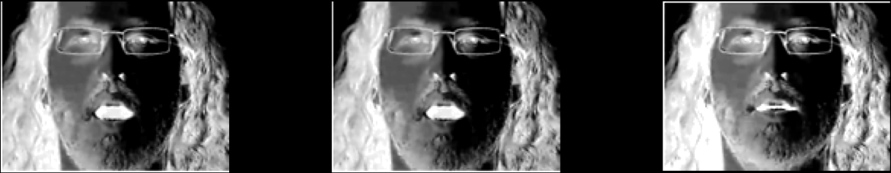
habituation
consistent
inconsistent
Sources Spelke 1991, Gergely, Csibra & Biro 1995, Csibra 2003 p. 125 fig. 6, Mark Steyvers’ web page for PSYCH 140C
Notes:
... in case they object that modularity can’t explain predictions ... the McGurk barrier case is an example of predicting an action

Slide 119
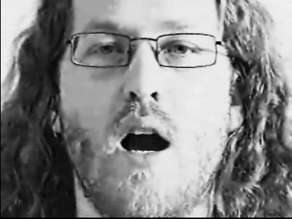
Notes:
Furthermore, how speech stimuli are categorically perceived depends on visual as well as auditory information (McGurk and MacDonald 1976).

Slide 120
Notes:
Furthermore, how speech stimuli are categorically perceived depends on visual as well as auditory information (McGurk and MacDonald 1976).

